Slide 1

Predicted house prices
Participated in KAGGLE competition.
Predicted prices of houses with numerous factors using supervised learning.

Slide 2
Brief of data
~Training set containing 80 columns and 1461
rows.
~Containing 6965 NA values in the dataset.
~Changing columns according to the
description file given.

Slide 3
STEPS
Changing NA values to the relevant values in the factor columns.
Plotting graphs of relevant columns to get useful insights.
Removing irrelevant columns using the correlation matrix.
Removing the NA values.
Applying the algorithms of supervised learning.

Slide 4
CHANGING NA values in factor columns
Alley-"No Access"
FireplaceQu-"No Fireplace"
BsmtQual-"No~Basement"
BsmtCond-"NoBasement"
BsmtExposure-"NoBasement"
BsmtFinType1-"No-Basement"
BsmtFinType2-"No_Basement"
GarageType-"NoGarage"
GarageFinish-"No-Garage"
GarageQual-"No_Garage"
GarageCond-"No~Garage"
PoolQC-"No Pool"
Fence-"No Fence"
MiscFeature-"None"

Slide 5
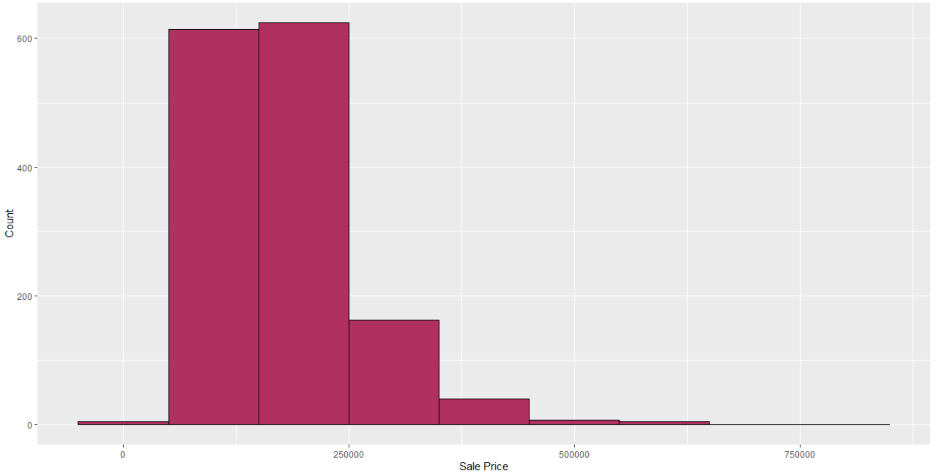
PLOTTING SALE PRICE
Count
Sale Price

Slide 6
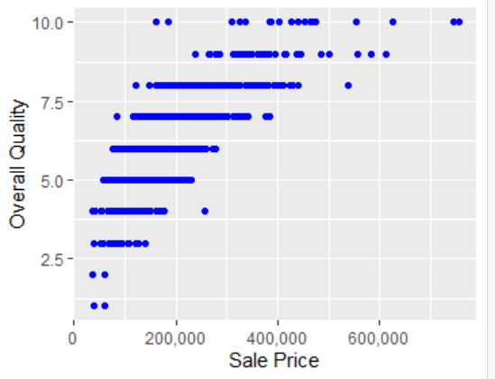
Plotting overall qual and sales
This shows quality above 8 houses were sold at very high prices.

Slide 7
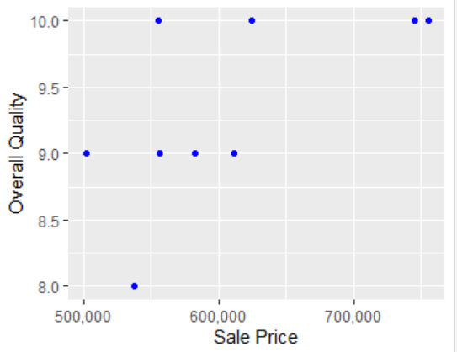
CHECKING THE QUALITY OF HOUSES THAT ARE SOLD AT HIGHEST PRICES
THIS SHOWS HOUSES HAVING 9 OR ABOVE WERE SOLD AT HIGHEST PRICES.
IN PREVIOUS VIZUALTISATION, THE COCLUSION WAS HOUSES ABOVE 8 WERE HAVING HIGH PRICES.
BUT THIS IS NOT THE ACTUAL CASE

Slide 8
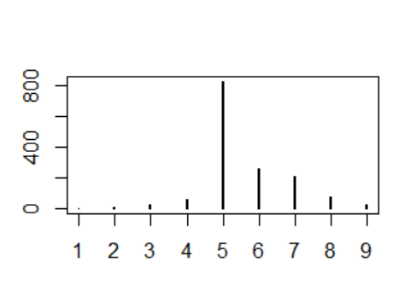
PLOTTING OVERALL COND (CONDITION)
In the data set no of houses having overall condition 5 were abundant.
OVERALL COND

Slide 9
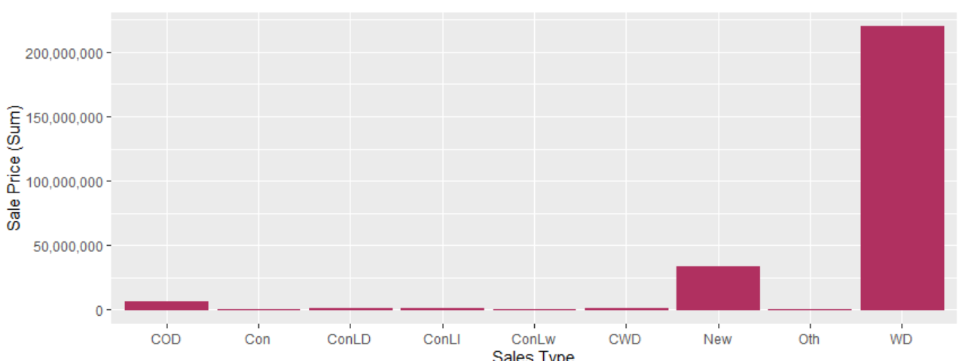
PLOTTING SALES TYPE OF HOUSES
WD sale type contributes highest significance in price determination.

Slide 10
REMOVING THE NA VALUES
USING THE OMIT FUCTION IN R.
TO PLOT THE CORRELATION MATRIX OF NUMERIC COLUMNS IN THE DATASET.

Slide 11
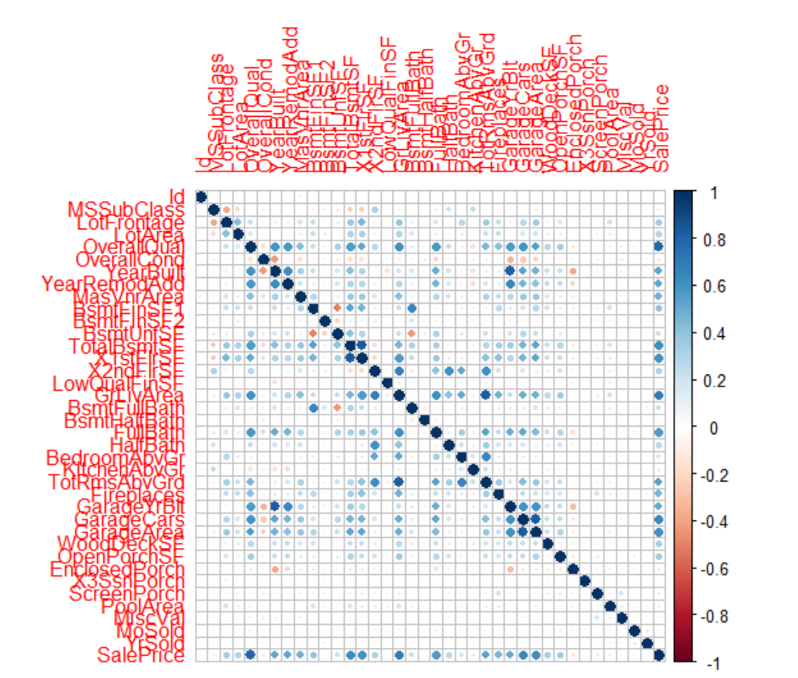

Slide 12
Removing COLUMNS DOES NOT SHOW ANY MAJOR SIGNIFICANCE TO THE SALES PRICE OF THE HOUSES.

Slide 13
NOW APPLYING ALOGRITHMS
LINEAR REGRESSION
I GOT A SCORE OF 0.24670
USING LINEAR RERESSION
DECISION TREES
I GOT A SCORE OF 0.24403
USING DECISION TRESS
NOTE: THESE SCORES ARE PUBLIC SCORE WHICH ARE BASED ON SOME PART OF THE PREDICTION

Slide 14
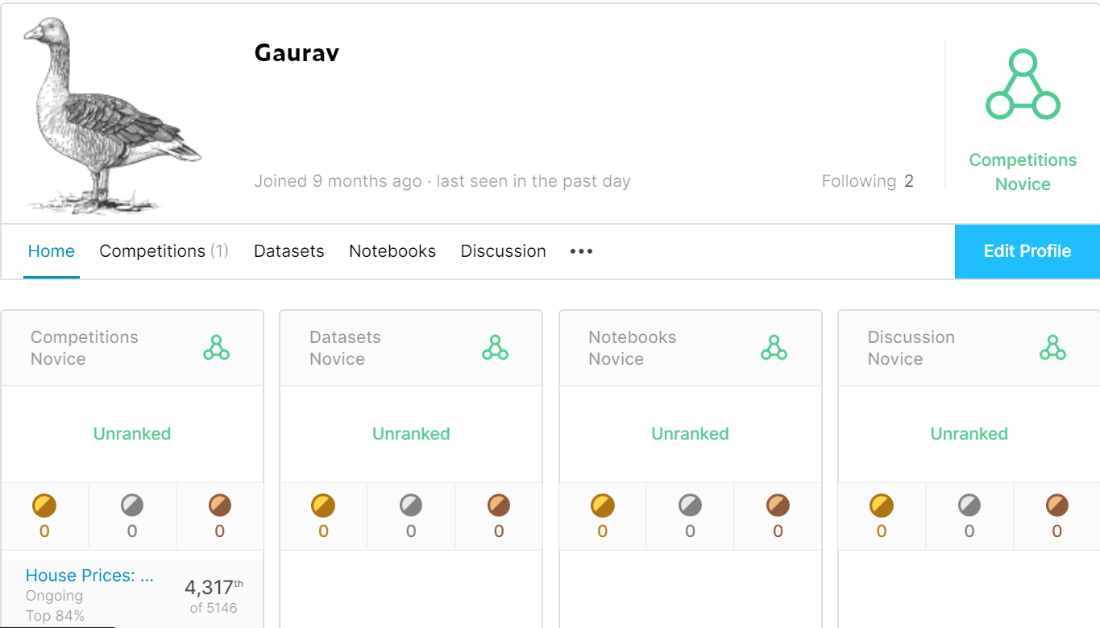
https://www.kaggle.com/gauravss
PROFILE LINK(KAGGLE)

